Slide 1

Block Coding Developer
Session 40
Turtle Programming App

Slide 2

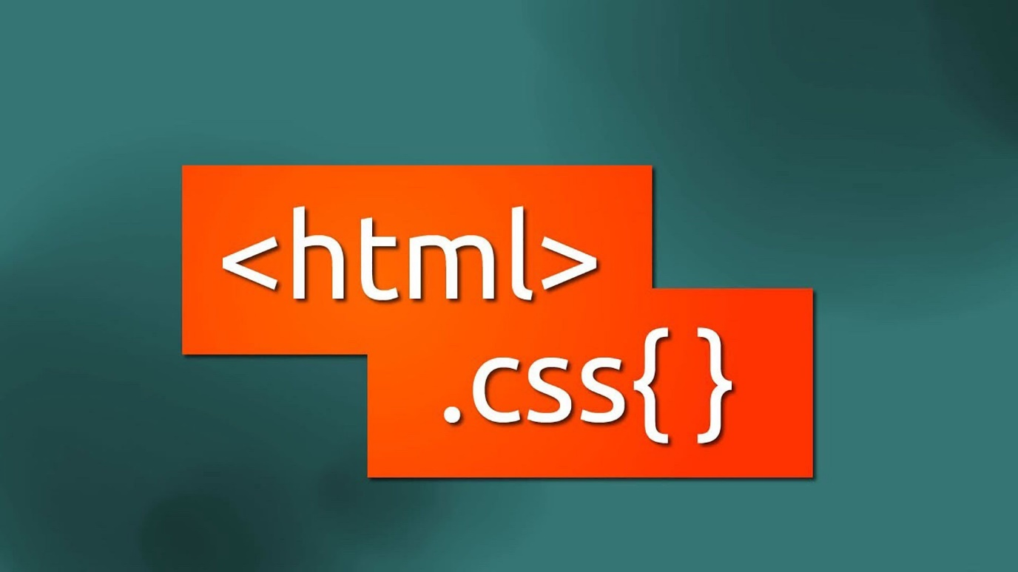
Recall…
What we have learnt in last session
What challenges you are facing

Slide 3
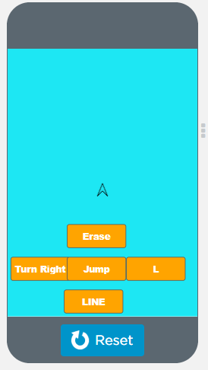
Turtle Introduction…
We will Learn today:
What is Turtle?
Turtle graphics element of the App Lab platform
Turtle Graphics Concept

Slide 4
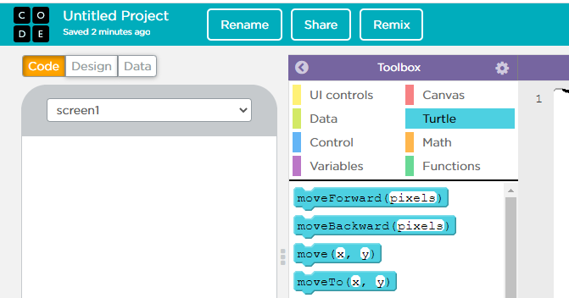
What is Turtle…
Turtle Graphics are an easy way to learn computer programming and to do computer graphics
You give simple commands to a Turtle and it moves accordingly
The Turtle has a pen in its belly, so that as it moves it can mark the screen

Slide 5
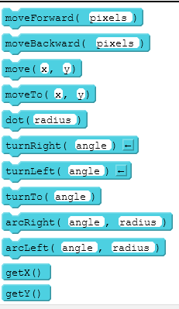
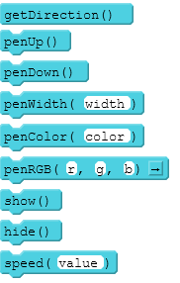
Turtle graphics element of the App Lab platform…
Move forward some distance
Move backward some distance
Turn right so many degrees
Turn left so many degrees
Lift the pen up
Put the pen down
Change the colour of the pen
Change the width of the pen

Slide 6
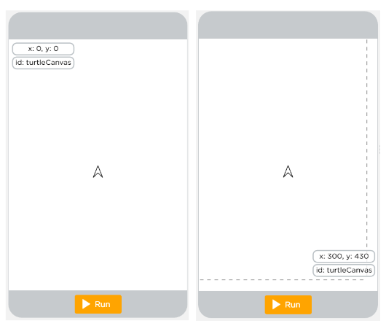
Turtle Graphics Concepts…
It is a key element of the AppLab development platform
The phone “canvas” uses a coordinate system measured in pixels
The top left corner has coordinates x:0, y:0
The bottom right corner has coordinates x:319, y:449
The canvas is 320 pixels wide and 450 pixels high

Slide 7
Graphics Application…

Slide 8
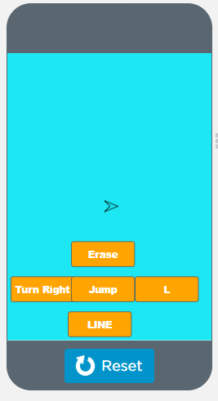
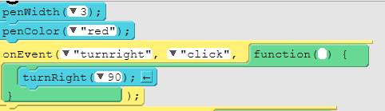
turnRight()…
turnRight() is one of the ways to change the turtle's orientation
Rotates the turtle right by the specified angle

Slide 9
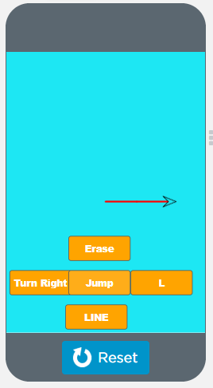
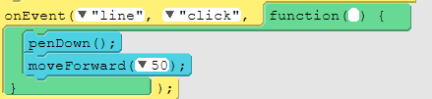
moveForward()…
With moveForward(), you can move, and draw with, the turtle anywhere on the screen in the forward direction

Slide 10
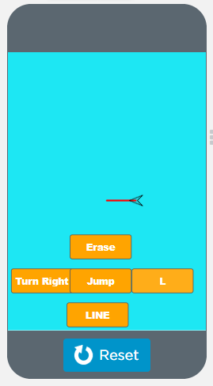
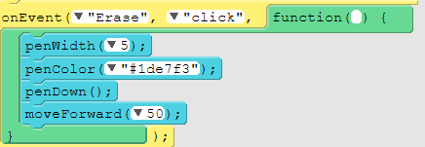
Erase…
Erase command is used to erase the drawn line

Slide 11
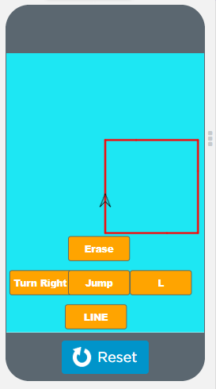
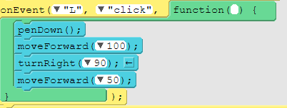
Draw Rectangle…
For drawing a rectangle you will have to move forward and then turn right or left till you reach the starting point

Slide 12
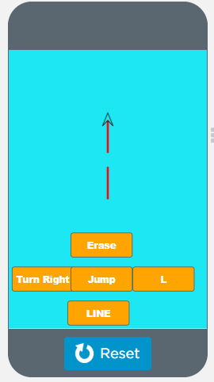
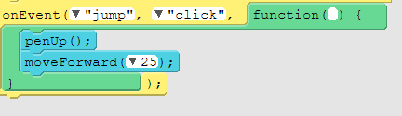
Jump…
With this command you can jump the line

Slide 13

Summary…
What is Turtle?
Turtle graphics element of the App Lab platform
Turtle Graphics Concept

Slide 14
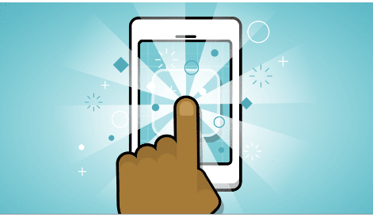
Next Session…
Rich GUI Apps in App Lab.
Create Slider, checkbox, and other controls in app

